Slide 1

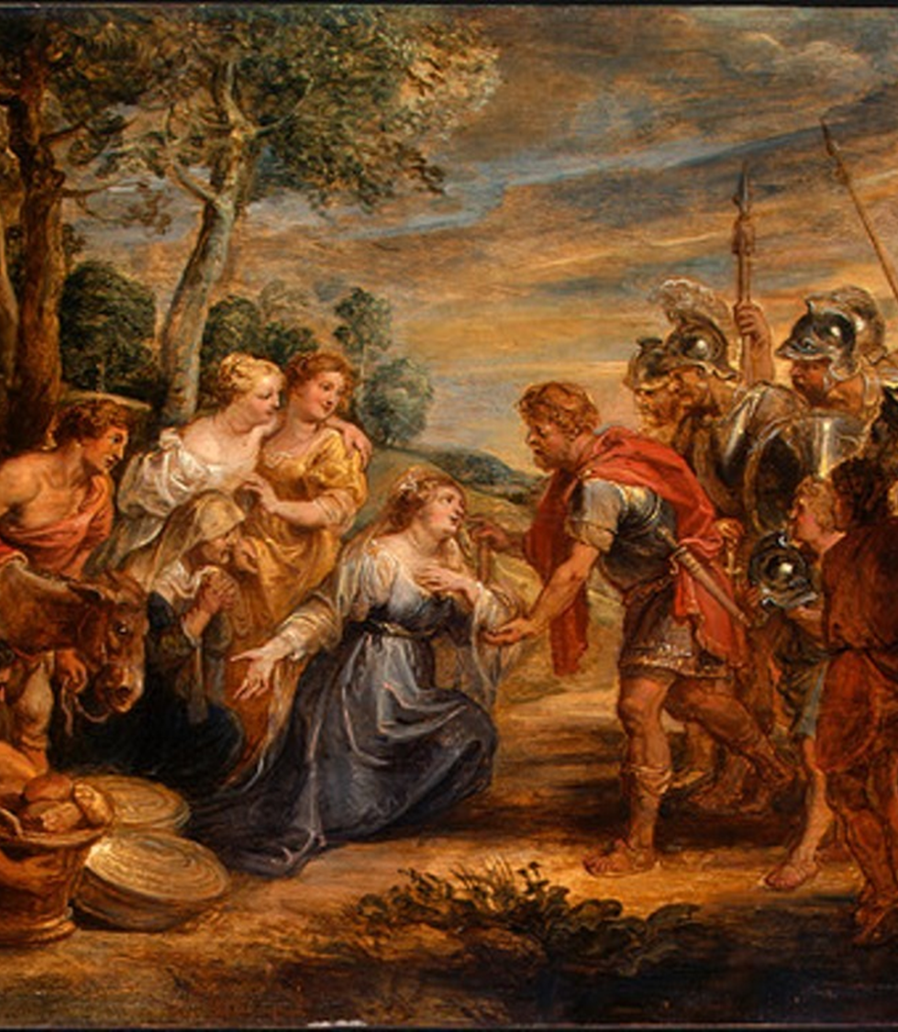
David’s Wrath
1 Samuel 25

Slide 2
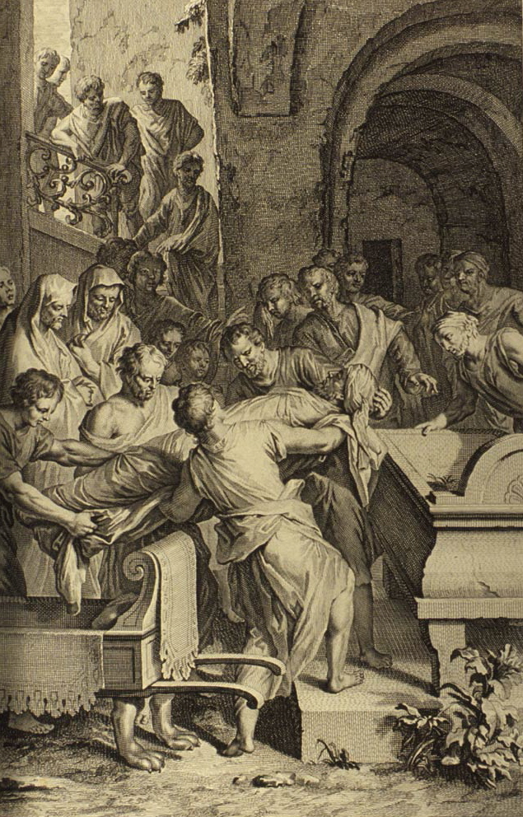
Samuel Dies.
It’s a great loss when great people die.
Know that the day of your death is coming too.

Slide 3
Romans 5:12 Wherefore, as by one man sin entered into the world, and death by sin; and so death passed upon all men, for that all have sinned:
Ecclesiastes 3:20 All go unto one place; all are of the dust, and all turn to dust again.
Job 30:23 For I know that thou wilt bring me to death, and to the house appointed for all living.

Slide 4
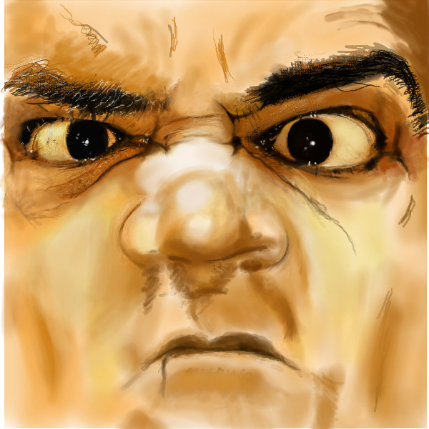
David’s need rebuffed by selfish Nabal.
There can be no hope in a fool.

Slide 5
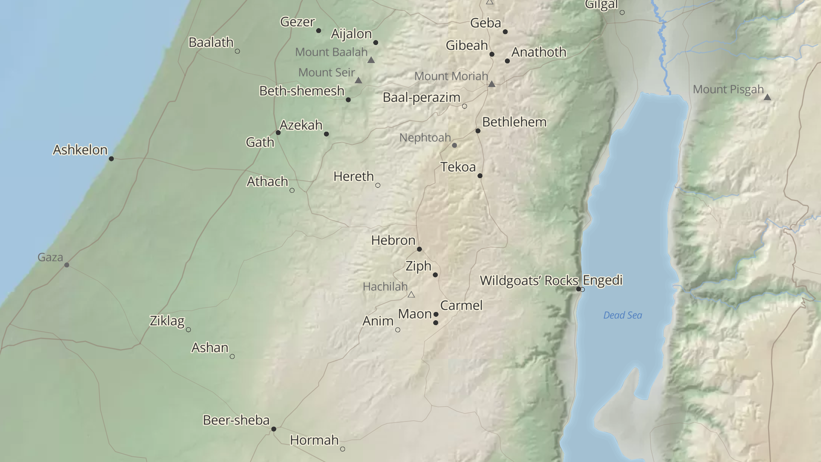


Slide 6
David’s need rebuffed by selfish Nabal.
There can be no hope in a fool.
Region: Carmel = “fruitful / plentiful place”
Rich!
Wonderful wife. Abigail =
“My Father is Rejoicing”
Wicked man. Nabal = “fool”
He was churlish (suborn, cruel, hard) and EVIL in his doings.

Slide 7
Isaiah 32:6 For the vile person will speak villany, and his heart will work iniquity, to practise hypocrisy, and to utter error against the LORD, to make empty the soul of the hungry, and he will cause the drink of the thirsty to fail.

Slide 8
NABAL FORGOT THAT GOD WAS WATCHING HIS TREATMENT OF OTHERS.

Slide 9
Psalm 14:1 The fool hath said in his heart, There is no God. They are corrupt, they have done abominable works, there is none that doeth good.
Proverbs 18:2-3 A fool hath no delight in understanding, but that his heart may discover itself. 3 When the wicked cometh, then cometh also contempt, and with ignominy reproach.

Slide 10
NABAL vs ABIGAIL foolish wise
DIED PROMOTED

Slide 11
David’s call.
Nabal had peace because he
had David watching over him.
David makes himself a “son”
to Nabal.
Nabal was blessed to be a BLESSING! So are you.
To whom much is given,
much is required.

Slide 12
1 Timothy 6:17-19 Charge them that are rich in this world, that they be not highminded, nor trust in uncertain riches, but in the living God, who giveth us richly all things to enjoy; 18 That they do good, that they be rich in good works, ready to distribute, willing to communicate; 19 Laying up in store for themselves a good foundation against the time to come, that they may lay hold on eternal life.

Slide 13
2 Corinthians 8:14 But by an equality, that now at this time your abundance may be a supply for their want, that their abundance also may be a supply for your want: that there may be equality:

Slide 14
2 Corinthians 9:6-8 But this I say, He which soweth sparingly shall reap also sparingly; and he which soweth bountifully shall reap also bountifully. 7 Every man according as he purposeth in his heart, so let him give; not grudgingly, or of necessity: for God loveth a cheerful giver. 8 And God is able to make all grace abound toward you; that ye, always having all sufficiency in all things, may abound to every good work:

Slide 15
Nabal’s wicked responce.
Nabal called David a rebel in
vs 10. Is he loyal to Saul?
The real issue?
His only care is for himself.

Slide 16
Luke 18:22-24 Now when Jesus heard these things, he said unto him, Yet lackest thou one thing: sell all that thou hast, and distribute unto the poor, and thou shalt have treasure in heaven: and come, follow me. 23 And when he heard this, he was very sorrowful: for he was very rich. 24 And when Jesus saw that he was very sorrowful, he said, How hardly shall they that have riches enter into the kingdom of God!

Slide 17
Proverbs 18:6-7 A fool's lips enter into contention, and his mouth calleth for strokes. 7 A fool's mouth is his destruction, and his lips are the snare of his soul.

Slide 18
Luke 12:15-21 And he said unto them, Take heed, and beware of covetousness: for a man's life consisteth not in the abundance of the things which he possesseth. 16 And he spake a parable unto them, saying, The ground of a certain rich man brought forth plentifully: 17 And he thought within himself, saying, What shall I do, because I have no room where to bestow my fruits? 18 And he said, This will I do: I will pull down my barns, and build greater; and there will I bestow all my fruits and my goods. 19 And I will say to my soul, Soul, thou hast much goods laid up for many years; take thine ease, eat, drink, and be merry. 20 But God said unto him, Thou fool, this night thy soul shall be required of thee: then whose shall those things be, which thou hast provided? 21 So is he that layeth up treasure for himself, and is not rich toward God.

Slide 19
Matthew 25:43-46 I was a stranger, and ye took me not in: naked, and ye clothed me not: sick, and in prison, and ye visited me not. 44 Then shall they also answer him, saying, Lord, when saw we thee an hungred, or athirst, or a stranger, or naked, or sick, or in prison, and did not minister unto thee? 45 Then shall he answer them, saying, Verily I say unto you, Inasmuch as ye did it not to one of the least of these, ye did it not to me. 46 And these shall go away into everlasting punishment: but the righteous into life eternal.

Slide 20
Romans 2:5 But after thy hardness and impenitent heart treasurest up unto thyself wrath against the day of wrath and revelation of the righteous judgment of God;

Slide 21
The servant’s witness against Nabal.
Nabal is messed up and
everyone knows it.
He knows David will retaliate.
He knows he cannot go to Nabal. You cannot reason with evil.
Nabal is rich but a worthless man!

Slide 22
Judges 19:22 Now as they were making their hearts merry, behold, the men of the city, certain sons of Belial, beset the house round about, and beat at the door, and spake to the master of the house, the old man, saying, Bring forth the man that came into thine house, that we may know him.
Judges 20:13 Now therefore deliver us the men, the children of Belial, which are in Gibeah, that we may put them to death, and put away evil from Israel. But the children of Benjamin would not hearken to the voice of their brethren the children of Israel:
2 Corinthians 6:15 And what concord hath Christ with Belial? or what part hath he that believeth with an infidel?

Slide 23
1 Peter 5:5-6 Likewise, ye younger, submit yourselves unto the elder. Yea, all of you be subject one to another, and be clothed with humility: for God resisteth the proud, and giveth grace to the humble. 6 Humble yourselves therefore under the mighty hand of God, that he may exalt you in due time:

Slide 24
David’s Wrath
1 Samuel 25

